Slide 1

Metabolism
Lesson 1.3: Evaluating Initial Claims About Elisa

Slide 2
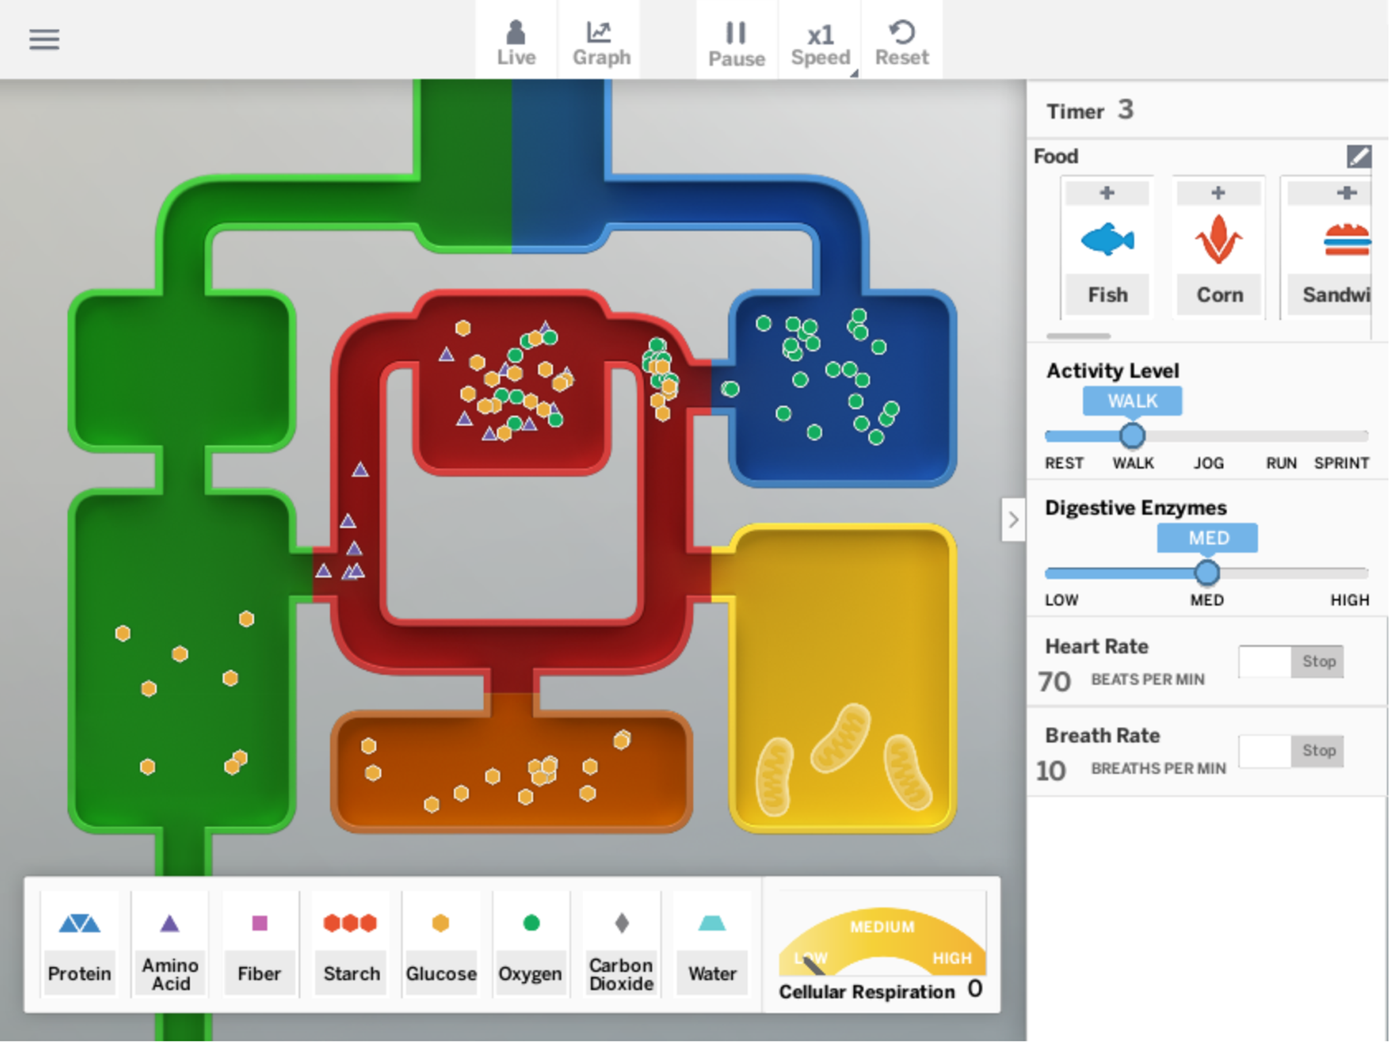
Reading "Molecules Cells Need"
In the Sim, we observed that in a healthy body, cells get certain molecules from food and air. Let’s review some of the words we saw in the Sim and their definitions.

Slide 3
molecule
a group of atoms joined together in a particular way

Slide 4
glucose
a molecule that organisms can use to release energy, and that is made of carbon, hydrogen, and oxygen atoms

Slide 5
oxygen
a molecule that organisms get from the air or water around them and use to release energy

Slide 6
amino acid
molecules that are the building blocks of proteins

Slide 7
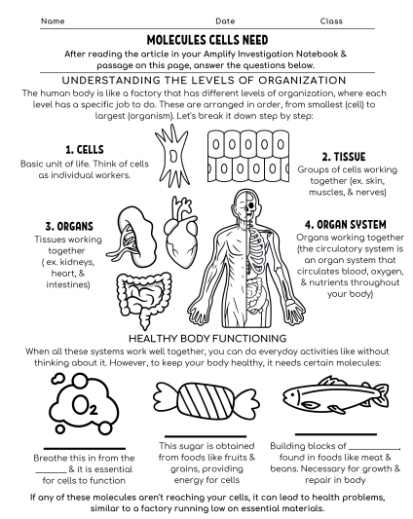
Reading "Molecules Cells Need"
Today, we’ll learn more about these molecules by actively reading an article.
Annotating a text means recording your own thinking as you read
You will now read and annotate the article “Molecules Cells Need.” then answer the article questions on the handout.
Reading this article will help us investigate why Elisa is feeling so tired all the time.

Slide 8
Reading "Molecules Cells Need"
Where does the body get each of these molecules?
glucose molecules
amino acid molecules
oxygen molecules
What do you think would happen if the human body doesn’t take in one or all of these molecules? Why do you think this?

Slide 9
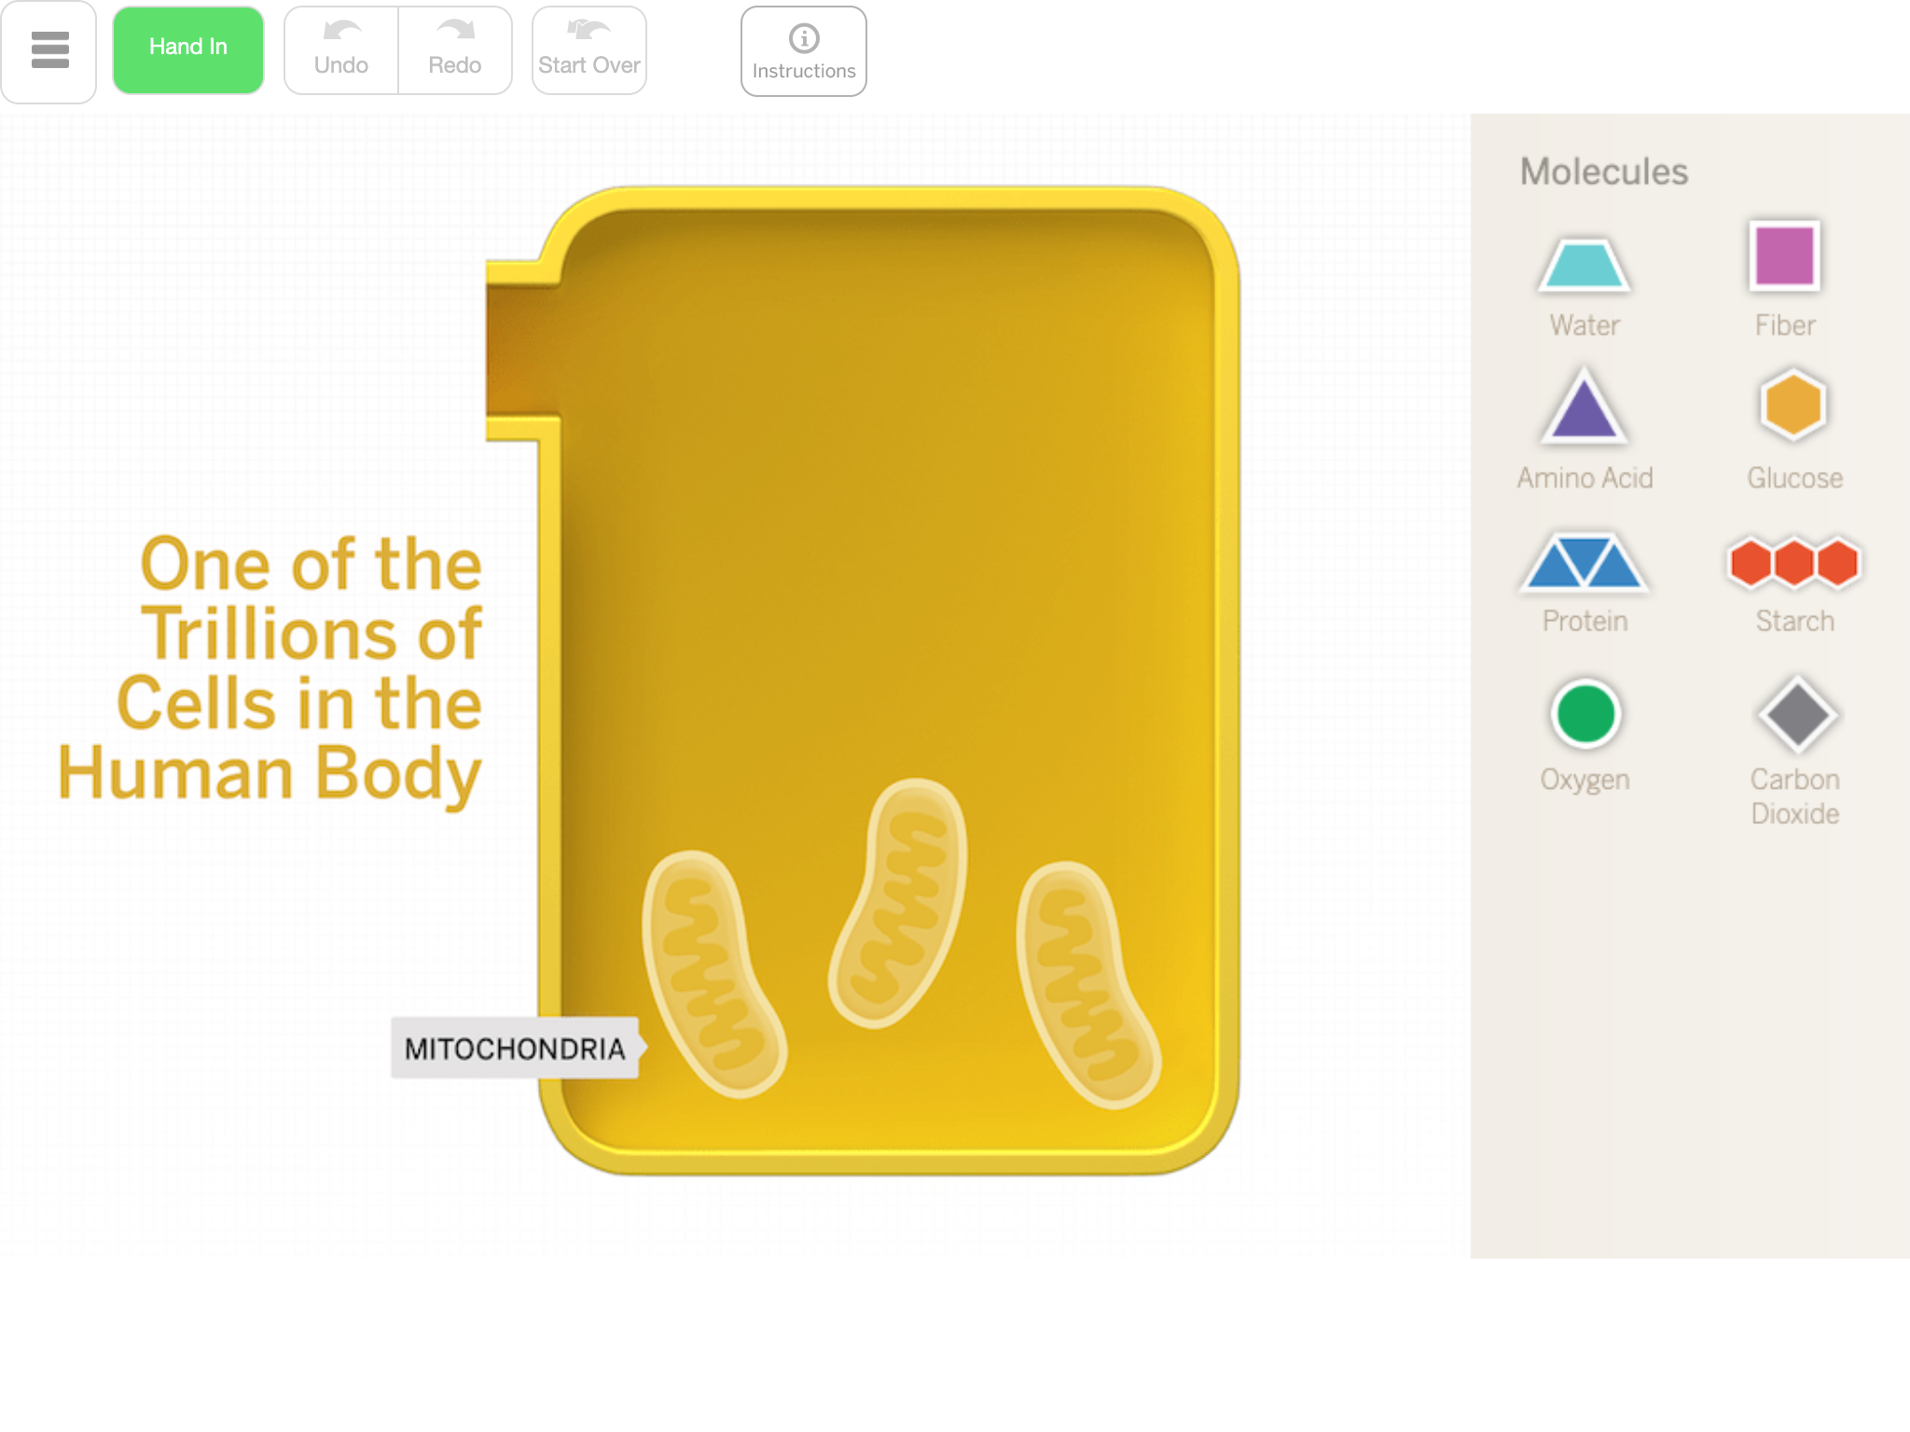
Modeling Molecules in a Healthy Cell
Before we can diagnose Elisa, we need to understand more about what’s happening in a healthy body. We’ll make models to show which molecules are found in a healthy cell.
We’ll use a digital tool called the Metabolism Modeling Tool.
Scientists often use models to work out their ideas and share them with others.

Slide 10


Slide 11
Key Concept #1:
A functioning human body has molecules from food (glucose and amino acids) and molecules from air (oxygen) in its cells.

Slide 12
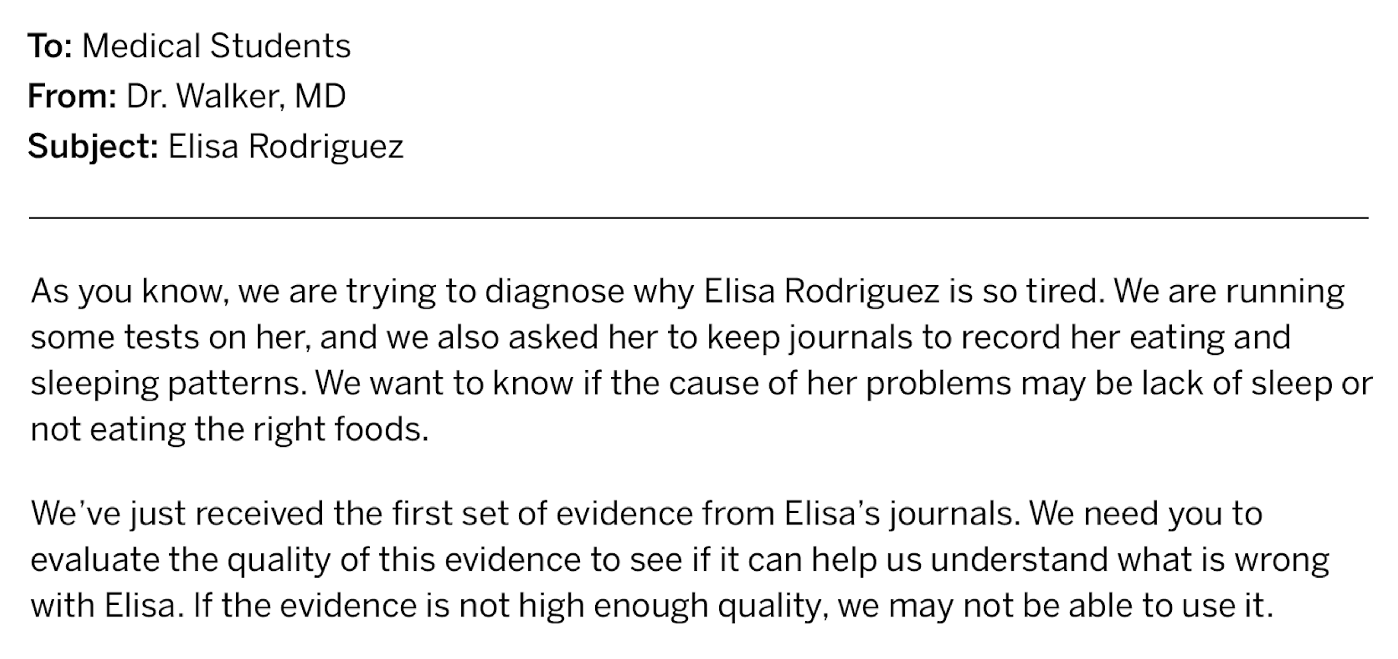
Evaluating New Evidence About Elisa

Slide 13
Evaluating New
Evidence About Elisa
Evidence is higher quality when it is based on more data because there can be more confidence in the patterns seen in the data.
With more data, you can trust the patterns that you see.
We will use this criterion to evaluate evidence.

Slide 14
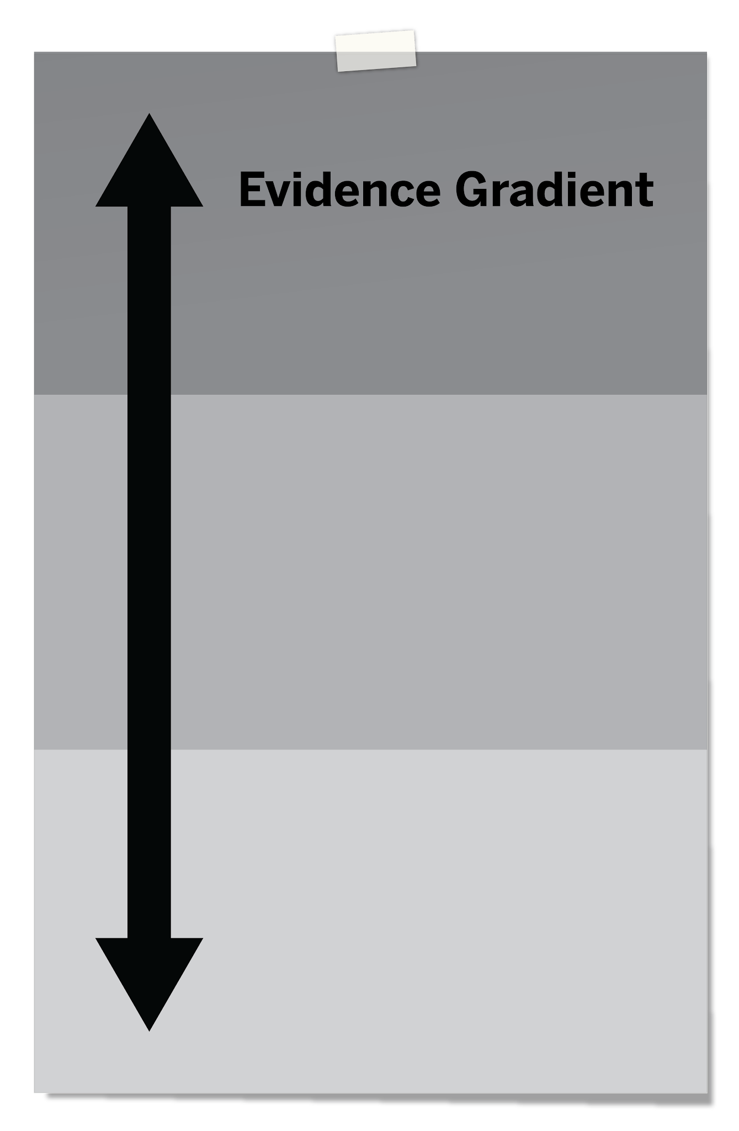

Evaluating New Evidence About Elisa
If a piece of evidence is high-quality (enough data), you’ll place it at the top.
If it is low-quality (not enough data), you’ll place it at the bottom.

Slide 15
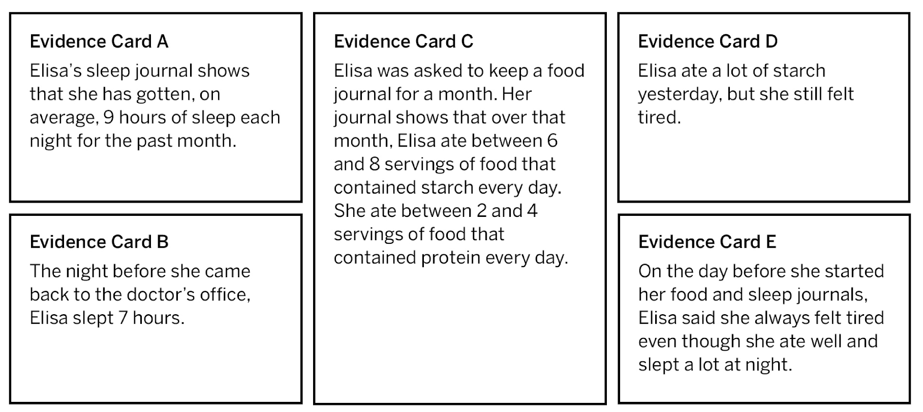
Evidence About Elisa

Slide 16
Evaluating Claims About Elisa
Claims
Elisa is feeling tired because she:
is not getting enough sleep.
is not eating enough food or not eating the right foods.
has a medical condition.
Let’s use what we’ve learned about healthy bodies and the evidence from Elisa’s journals to reconsider the claims about why Elisa feels tired.

Slide 17
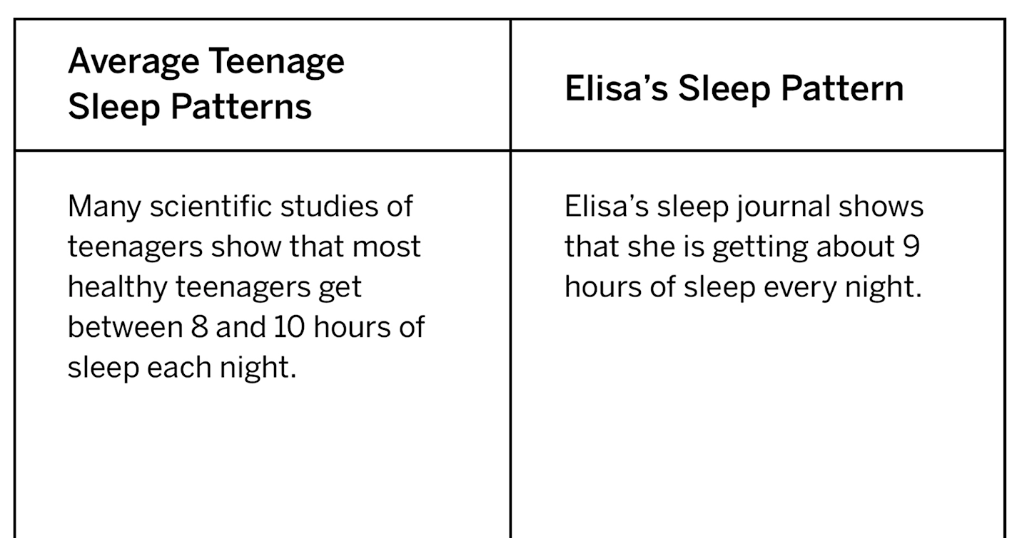
Evaluating Claims About Elisa

Slide 18
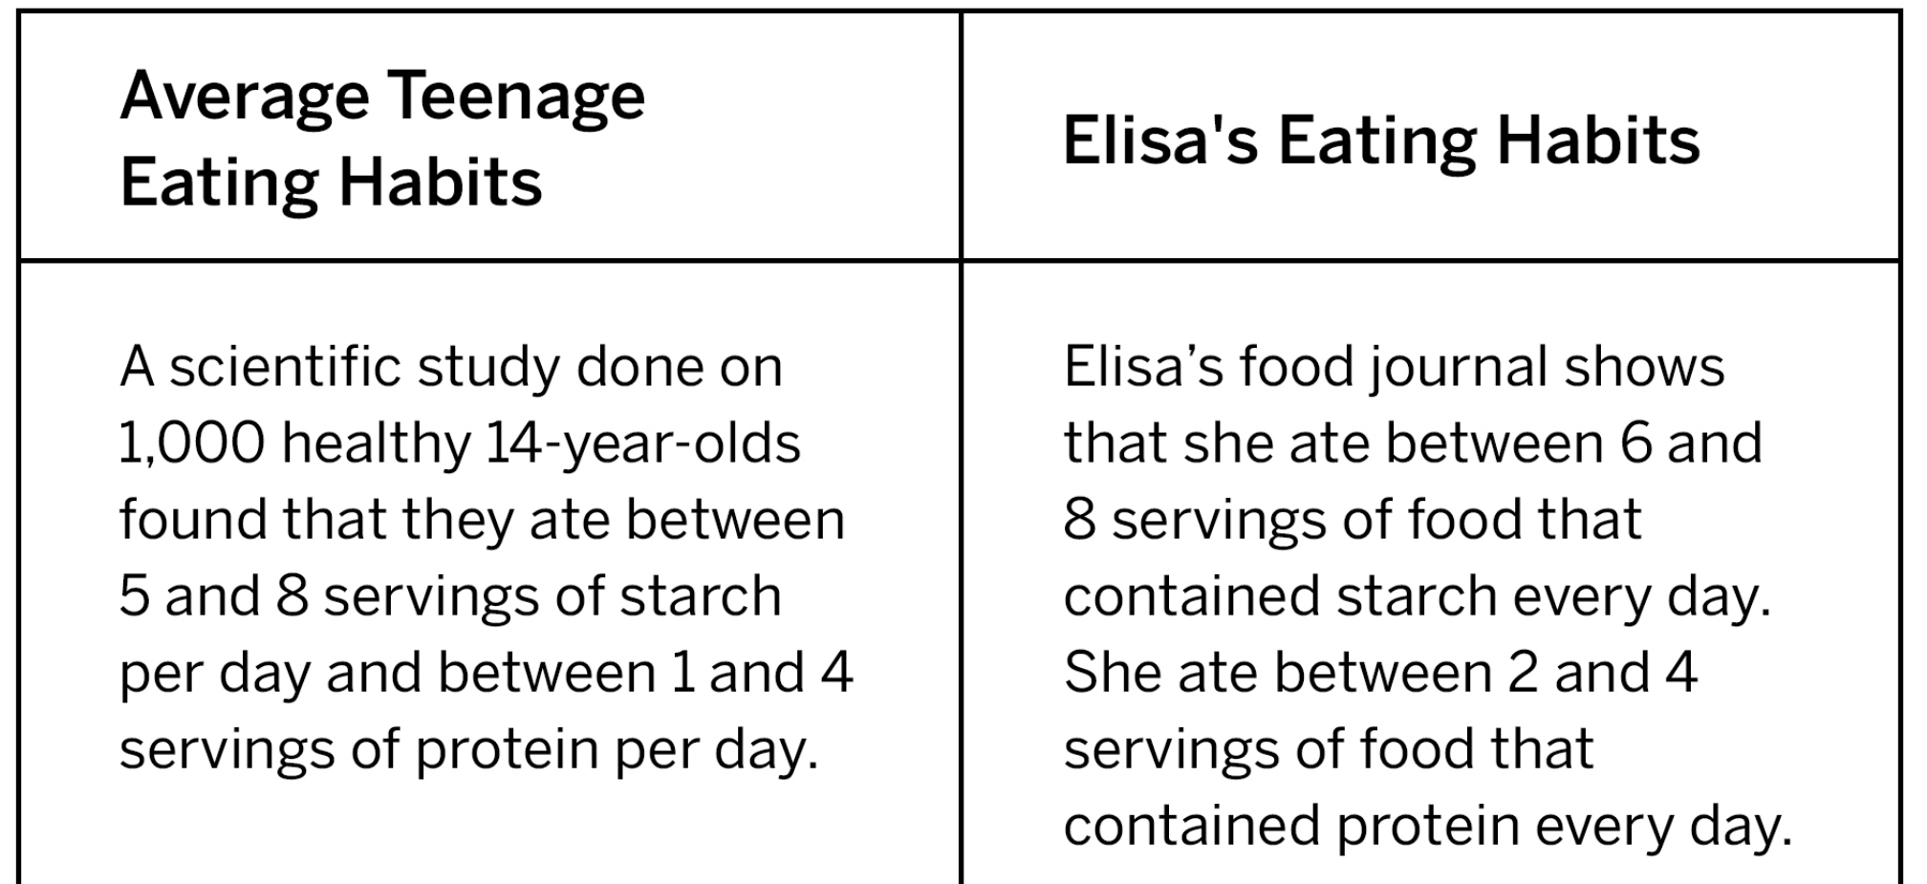
Evaluating Claims About Elisa

Slide 19
Evaluating Claims About Elisa
It looks like lack of sleep and poor eating habits do not explain Elisa’s tiredness.
Going forward, we’ll focus on whether Elisa has a medical condition that could be preventing the necessary molecules from getting to her cells. This might explain why she feels so tired.

Slide 21
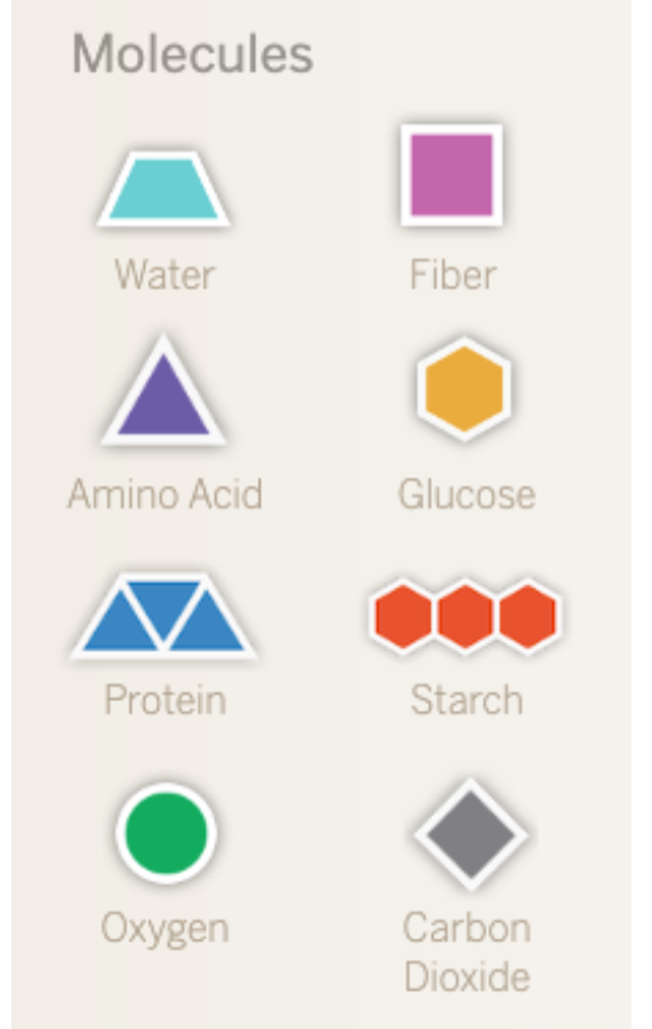
Homework pg 16
For this activity, you will think about the size of different molecules in the body and respond to some questions.

Slide 22
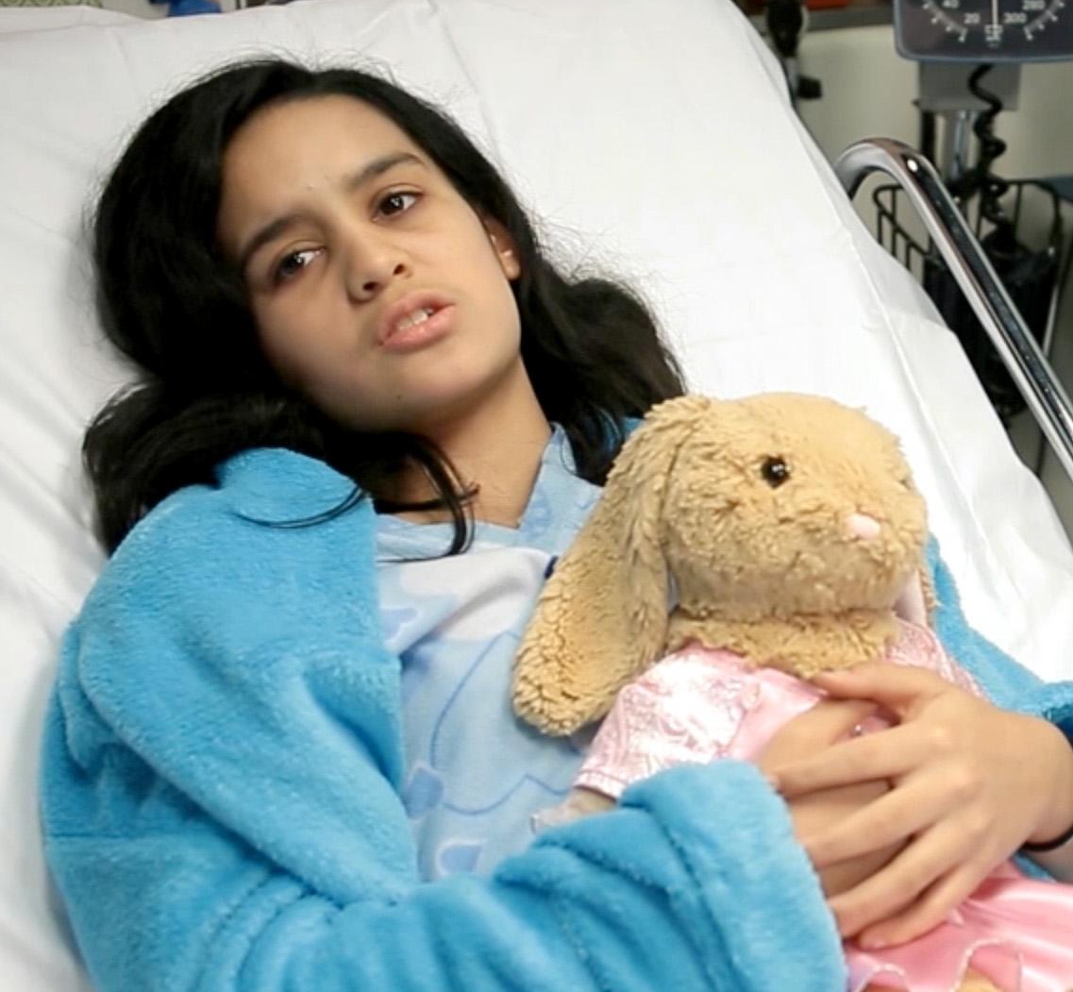
Self-Assessment pg 17-18
For this activity, you will have a chance to reflect on your learning so far.
You will revisit these questions at the end of every chapter.

